Slide 1
Retail RFID Anti-Theft Solution

Slide 2
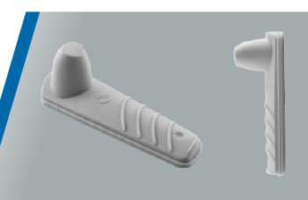
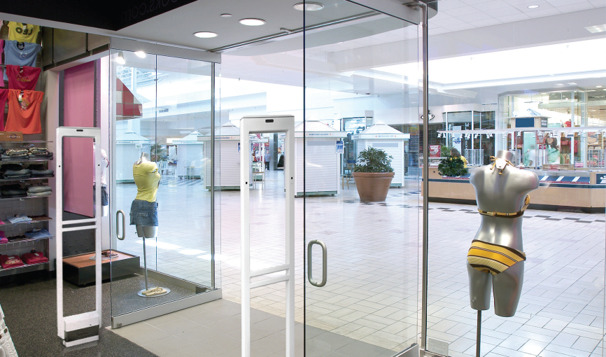
Traditional Anti-Theft System
EAS Tag Attached to Garments
Anti-theft reader at gate detects the EAS Tags
Tags removed from sold items

Slide 3
Disadvantages
EAS not provide identification
Inventory not possible
Shop billing employees can detach EAS tags and take out items without billing

Slide 4
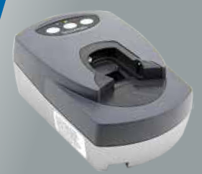
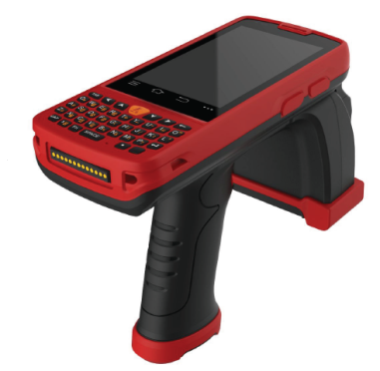
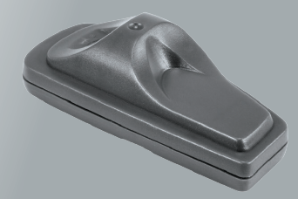
Solution
RFID + EAS Combo tags
RFID Enabled Power Detacher
RFID Enabled Gate Reader Or EAS Gate Reader
RFID Enabled billing
Portable reader for easy physical verification

Slide 5
Advantages
Easy inventory and Billing
Any theft items identified
Billing staff cannot detach tags without billing

